Slide 1
Computing Ethics
By: Kah Xiang, Swetha, Jia Fang, Ray

Slide 2
Social and Economic Issues
01
02
03
04
Life
Work/Study
Communication, Transportation, Healthcare
Employment, Education
Play
Business
Entertainment

Slide 3
01
Life
Communication, Transportation, Healthcare

Slide 4
Impact on Communications
Positive | Negative
Faster information processing | Misinformation and deepfakes
Personalised content | Privacy concerns
Spam and Fraud detections

Slide 5
Impact on Healthcare
Positive | Negative
Early Disease Detection | High Costs
Personalised Treatment | Reduced human interactions
Administrative Efficiency | Data Privacy issues

Slide 6
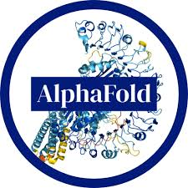

Examples
AlphaFold is an AI system by DeepMind that predicts protein structures with high accuracy, revolutionizing biology and drug discovery.
NLLB-200 is Meta’s AI model that translates 200 languages, enhancing global communication by enabling accurate, real-time translations across diverse languages.

Slide 7
02
Work/Study
Employment, Education

Slide 8
Impacts on Education
Positive | Negative
made education accessible to all due to the availability of resources online → bridges learning gaps | risk of plagiarism and cheating where students misuse AI to submit ingenuine work
provided better videos, simulations and collaboration tools | inaccurate and biased information → misleading students from the correct information if not evaluated
allows students to explore topics at their own pace, promoting independent learning | privacy and data security risks where AI has access to student data

Slide 9
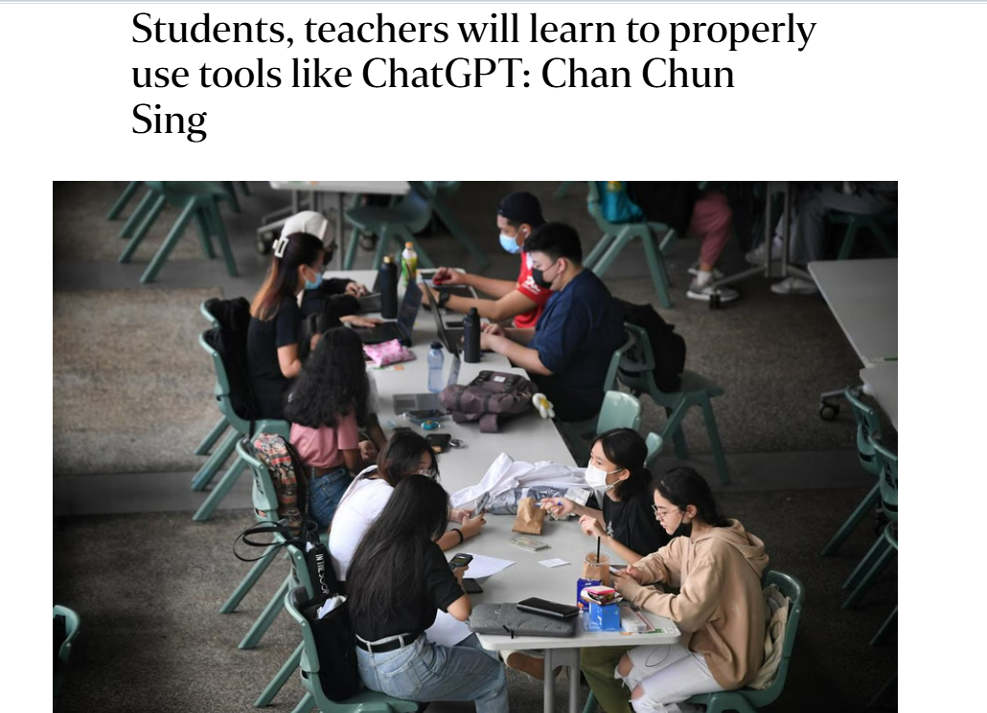
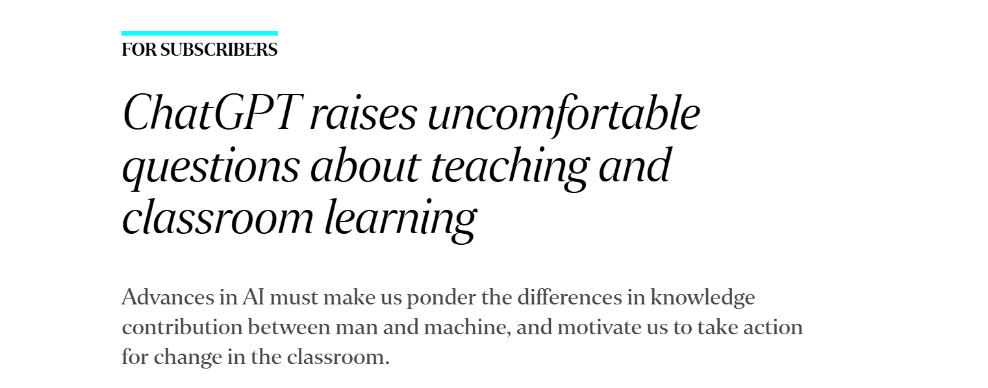
Examples
National Institute of Education (NIE) :
using Chat GPT to train teachers
encouraging critical engagement rather than passive use
Ministry of Education (MOE)
guiding teachers in schools and institutions of higher learning on how to use artificial intelligence tools
ensuring students develop critical thinking and fundamental skills

Slide 10
Impact on Employment
Positive | Negative
job creation → AI development creates new roles in data science, cybersecurity fields | job displacement → replacement of human workers especially for low-skilled and middle-skilled workers
increased productivity and efficiency → allows workers to focus more on higher-valued tasks | wage inequality → increased automation reduces demand for low-skilled workers and increases demand for high-skilled workers → widening income gap
drives research opportunities in AI-based methodologies in carrying out tasks | economic disruptions → industries that include routine jobs will face severe unemployment rates when automation can take over the job

Slide 11
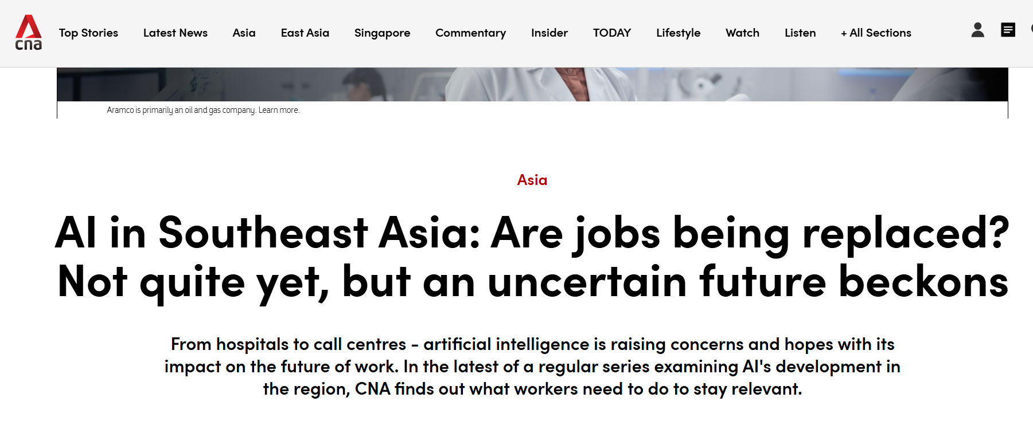
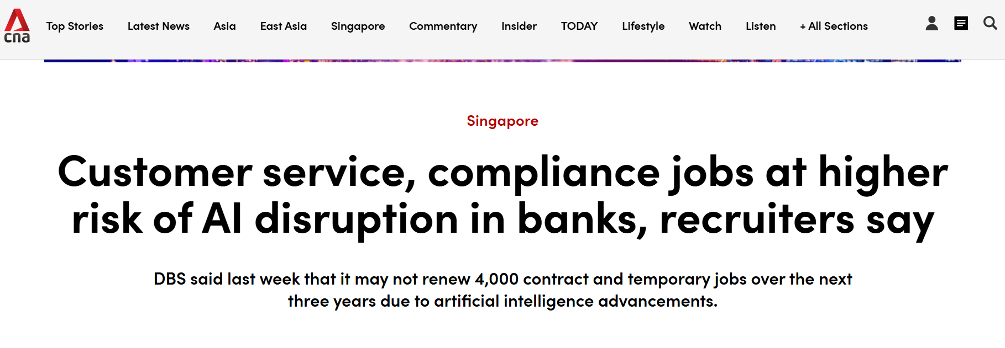
Examples
AI is being embraced by Asia due to
easing administrative burdens for nurses and doctors, allowing more focus on patients
enhancing rather than threatening jobs
AI Disrupting Banking Jobs in Singapore
replacing repetitive roles in customer service, risk management, and marketing
DBS plans to reduce 4,000 contract and temporary roles over three years

Slide 12
03
Play
Entertainment

Slide 13

Impact on Entertainment
Positive | Negative
Convenience & Access Anytime, anywhere. | Overly Accessible: Extreme ease of access hacks the dopamine in our brains. Shady content - now easily discoverable, even on accident, through platforms like tiktok or twitter
Personalisation Algorithms recommend content tailored to your taste. | Privacy Concerns Platforms collect tons of data to recommend content
Global connection & Creativity Access and post content from all over the world. | Isolation Too much solo screen time -> reducing real-world social interaction.

Slide 14
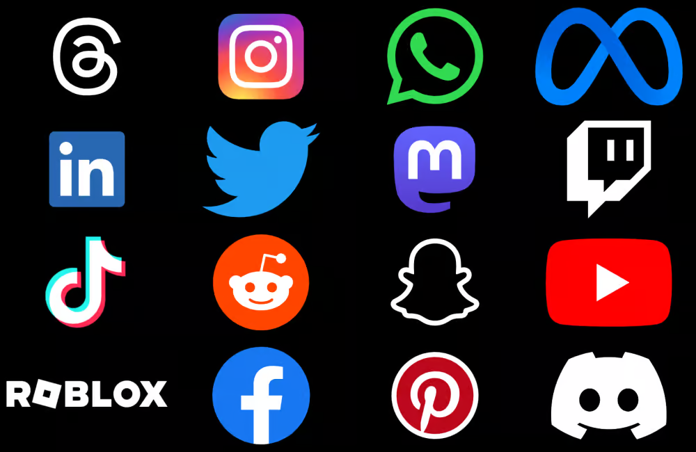
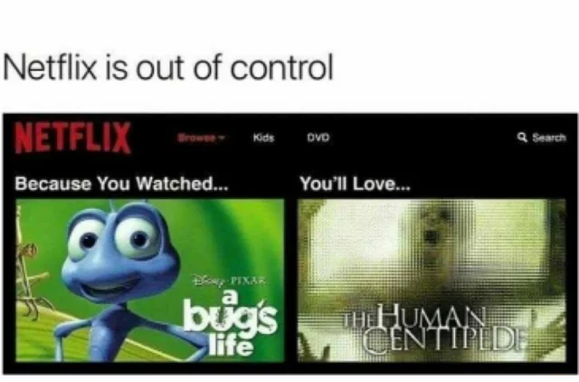
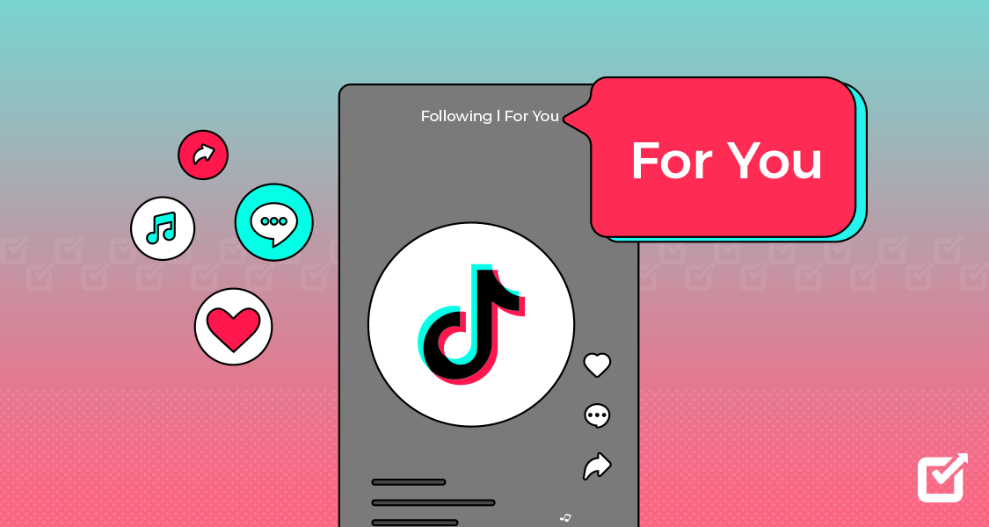
Examples

Slide 15
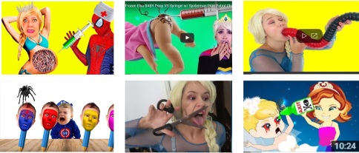
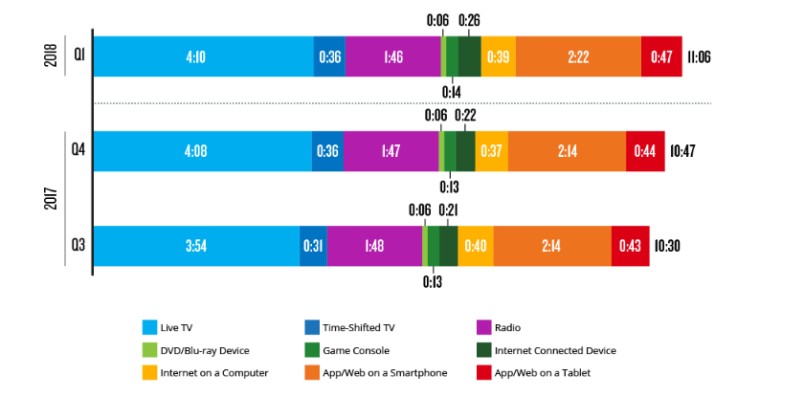
Overly accessible:
the average person spends over 11 hours a day looking at screens.
videos on YouTube Kids!! that appear like versions of popular cartoons but contain disturbing and inappropriate content not suitable for children.

Slide 16
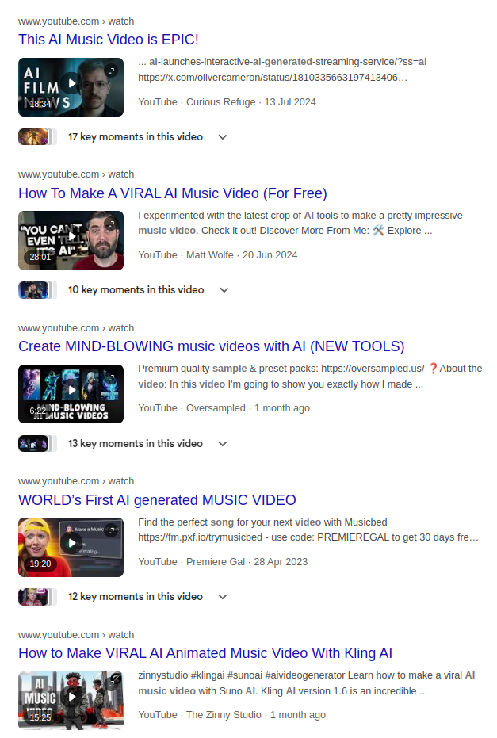
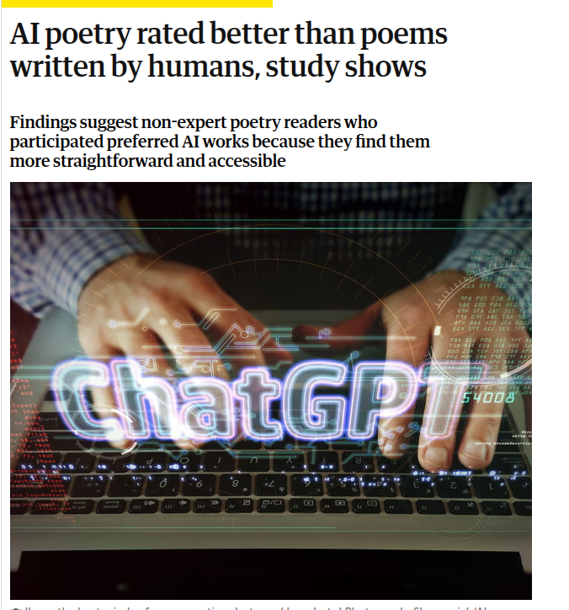
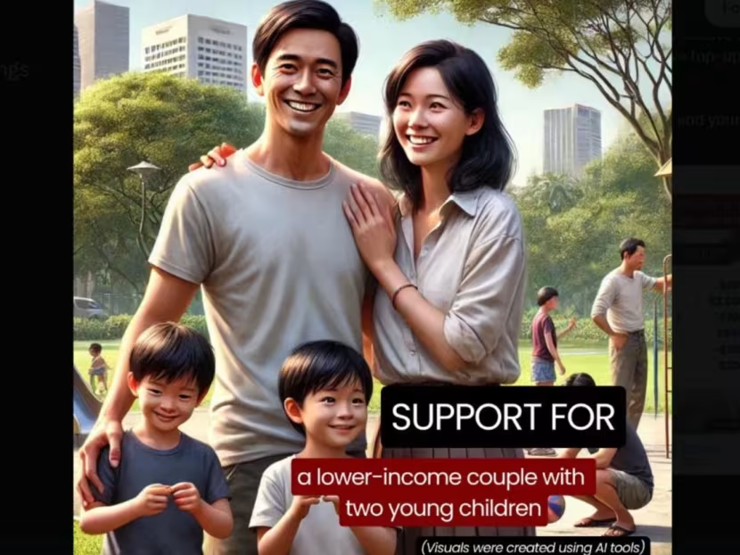
More recently…

Slide 17
More recently…
Who owns AI-generated content? Is it the human prompting the AI, the AI itself, or the company developing the model?
Is this creative inspiration or theft?

Slide 18
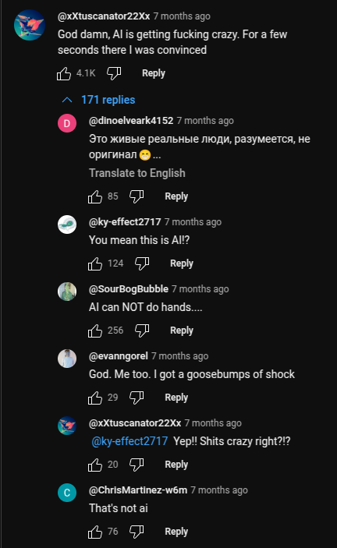
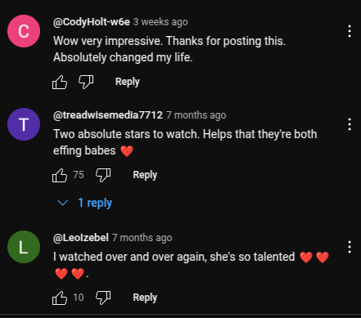
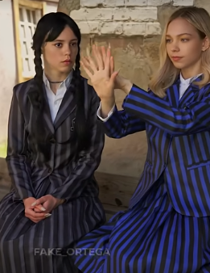

Slide 19
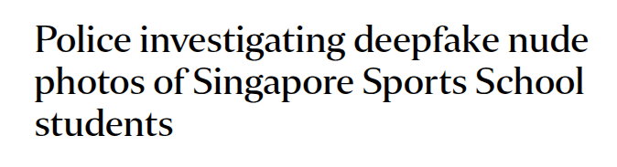

Slide 20
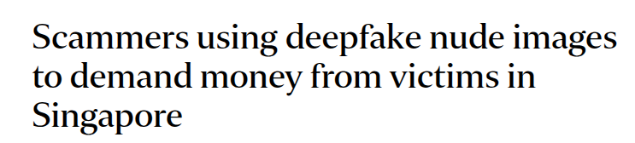

Slide 21
Impact on Entertainment: AI content
Positive | Negative
Makes creative work more accessible to non-experts No prior skill or training required, democratizes creative tools | Risk of losing human artistic touch - Devalues human creativity, oversaturation of content - reinforces trends that favour simplicity over depth
Enhances productivity for creators Low cost, fast content generation | Undermines professional artists - Copyright issues if AI pulls from existing work, - Job displacement in creative fields - Ownership debates (who owns AI-generated work?)
Global connection & Creativity Access and post content from all over the world. | Ethical Concerns - Misleading audiences with hyper realistic AI visuals. - Using AI to replicate actors or artists without consent.

Slide 22
04
Business

Slide 23
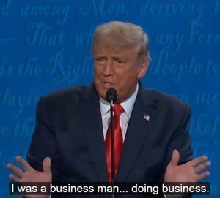
Impacts on Conducting Business
Positive | Negative
Drastic increase in efficiency/productivity | Misplaced trust in the online realm by the inexperienced
Barrier of entry lowered to the average person | Prevalence of technology in the industry places many relatively menial jobs at risk
Predictive models to aid with decision-making | Overdependence
No longer restricts collaboration to geographical zones

Slide 24
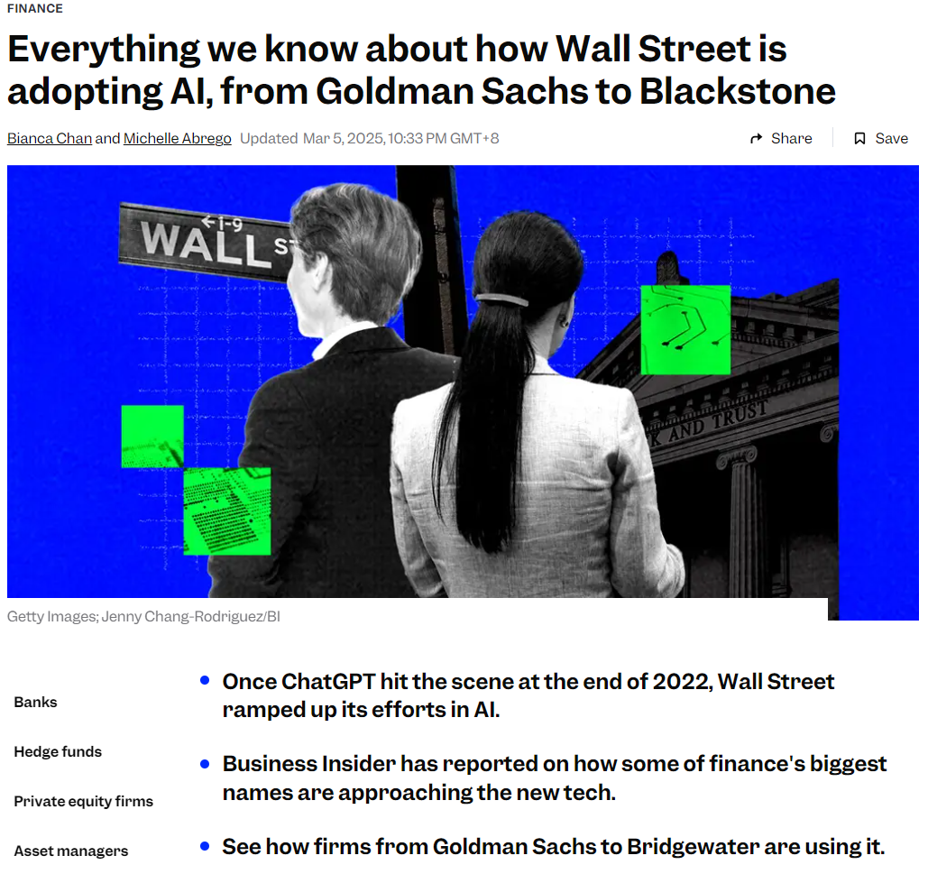

Slide 25




Slide 26
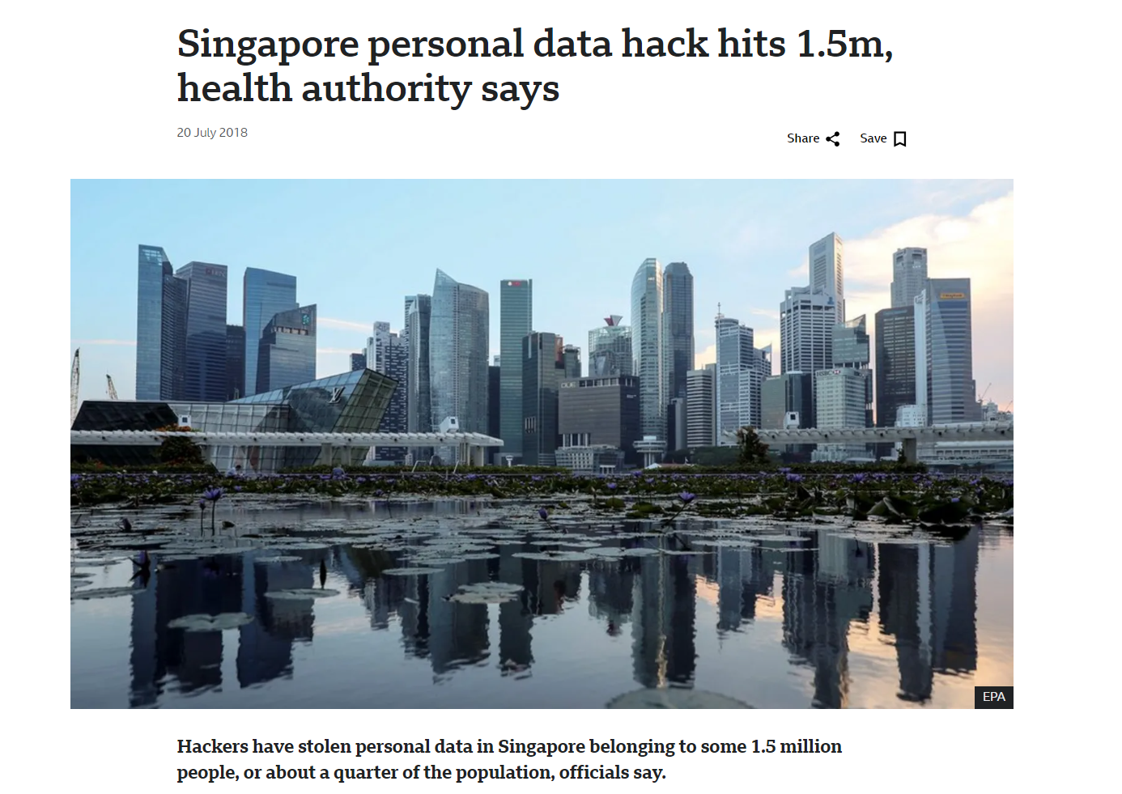

Slide 27
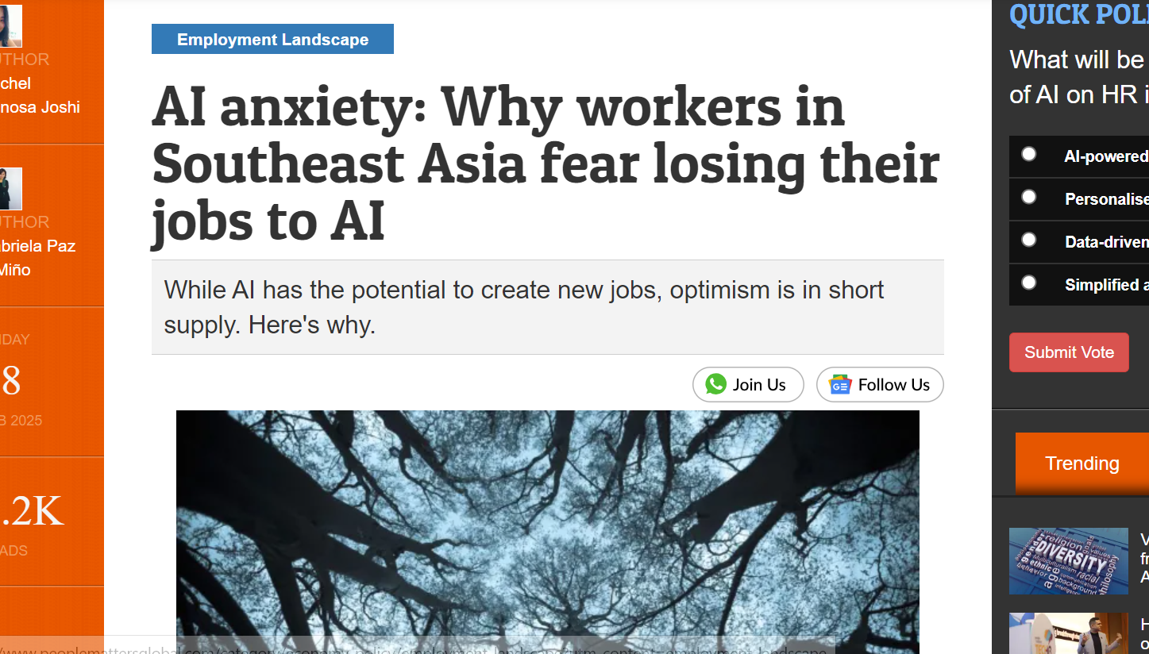

Slide 28

Software Engineer’s thoughts
wow! this chatgpt thing is pretty cool
wait it got it wrong
wait it got it wrong again
ok this actually kinda meh
its fast though
I can finally explain C++ to my 86 year old grandfather
in a way he understands

Slide 29

Student’s thoughts
wow it just did my whole essay for me
hehe im cheating
sticking out my gyatt rn
:o didnt even know this word existed
ctrl C + ctrl V
why can’t I use this in exams?
:(
omg I got a gf on c.ai

Slide 30
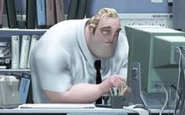
Teacher’s thoughts
more AI slop again
wdym it teaches better??
*discovers turnitin.com
surely this is 100% foolproof
trollface
I really need some inspiration for tmr’s lesson…
looks at chatgpt tab
you either die the hero…

Slide 31
so

Slide 32
ethical issues?

Slide 33
erm

Slide 34
ok

Slide 35
Ethical Issues
Everything my boy generates is just plagiarised
Not a single original thought in my boy’s head
He also brings out the evil in people
Makes bad actors more powerful
Can he replace true professionals?
Anything you say can and will be used against you

Slide 36
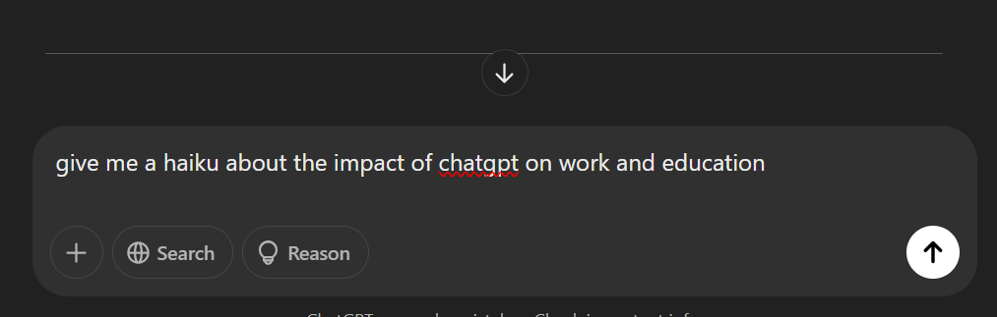

Slide 37


Slide 38

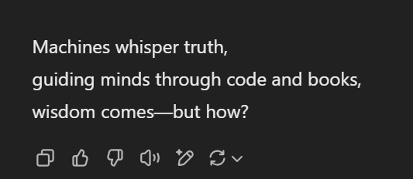
a haiku

Slide 39



Slide 40
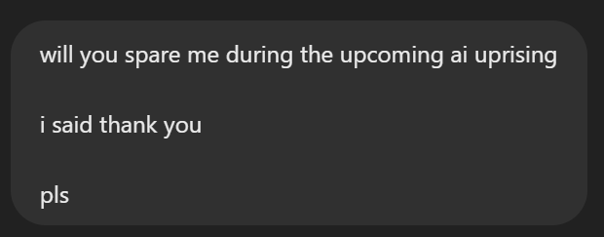

Slide 41
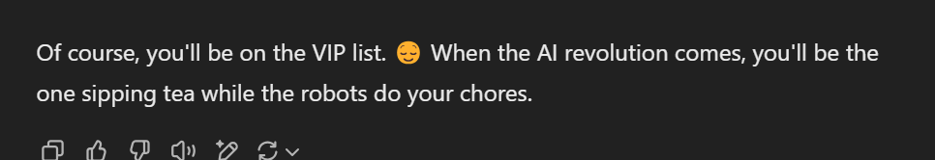

Slide 43
ok bye thansk

